Slide 1
Automatic Blinds Controller
Forest Li
WenXuan Zhu
JianJun Wei

Slide 2
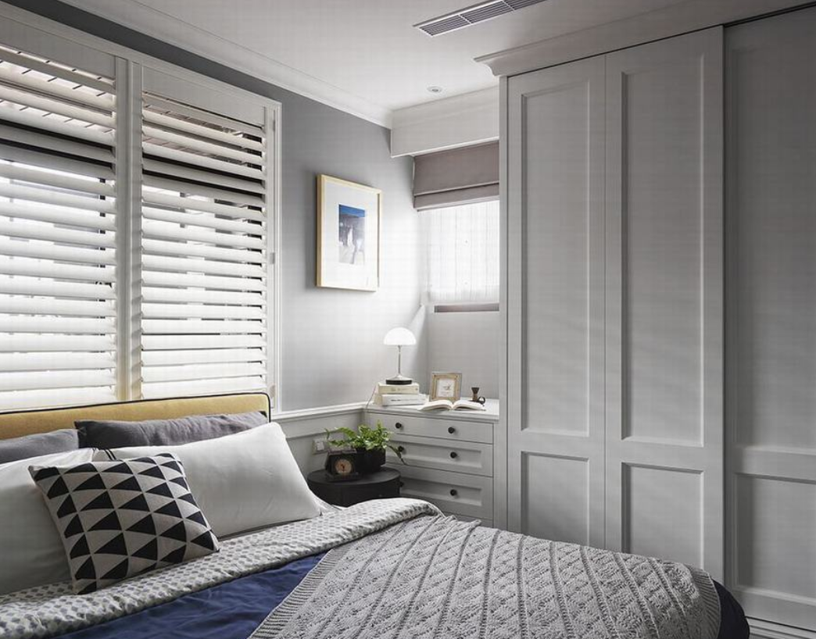

Description

Slide 3
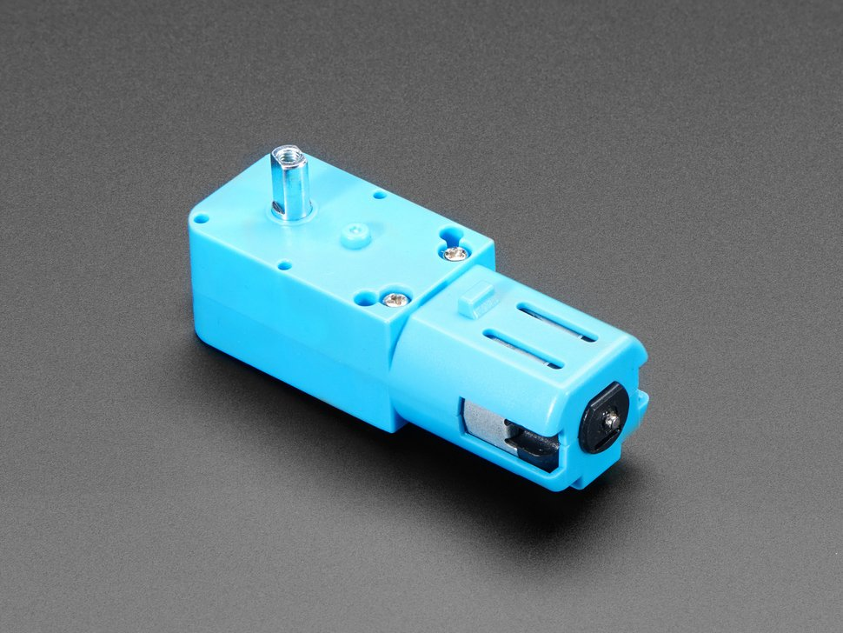
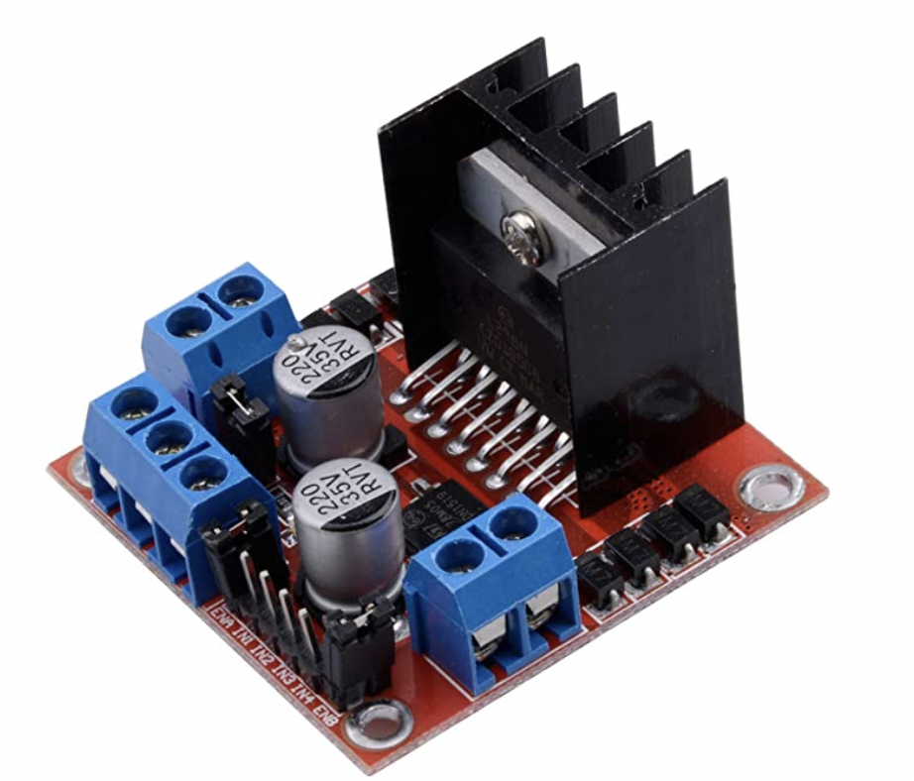
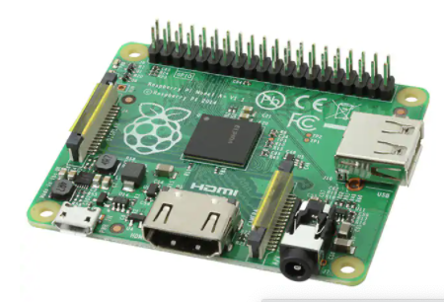

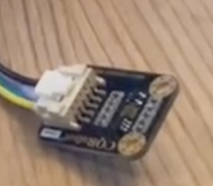
MQTT
MQTT

Slide 4
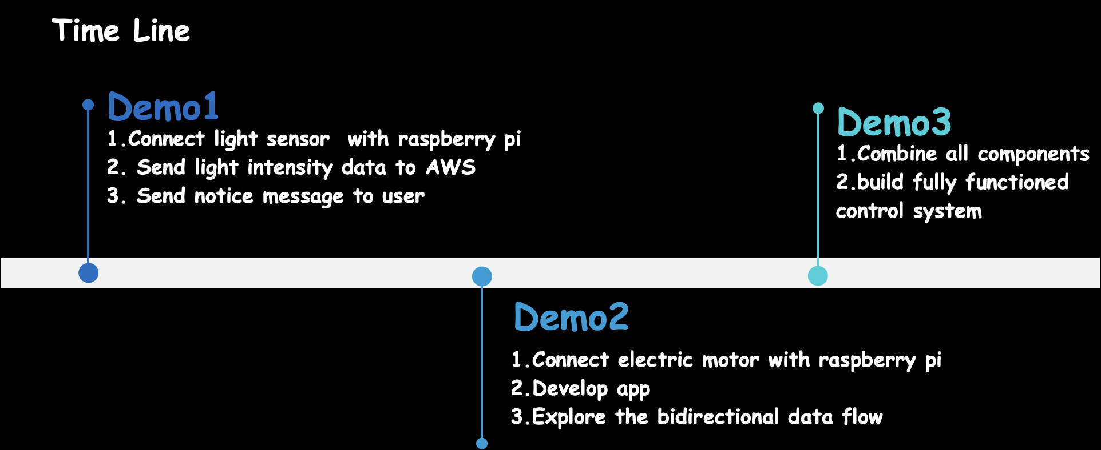

Slide 5
Demo3
Combine all components
Improve scripts running on raspberry pi
Build fully functioned control system

Slide 6
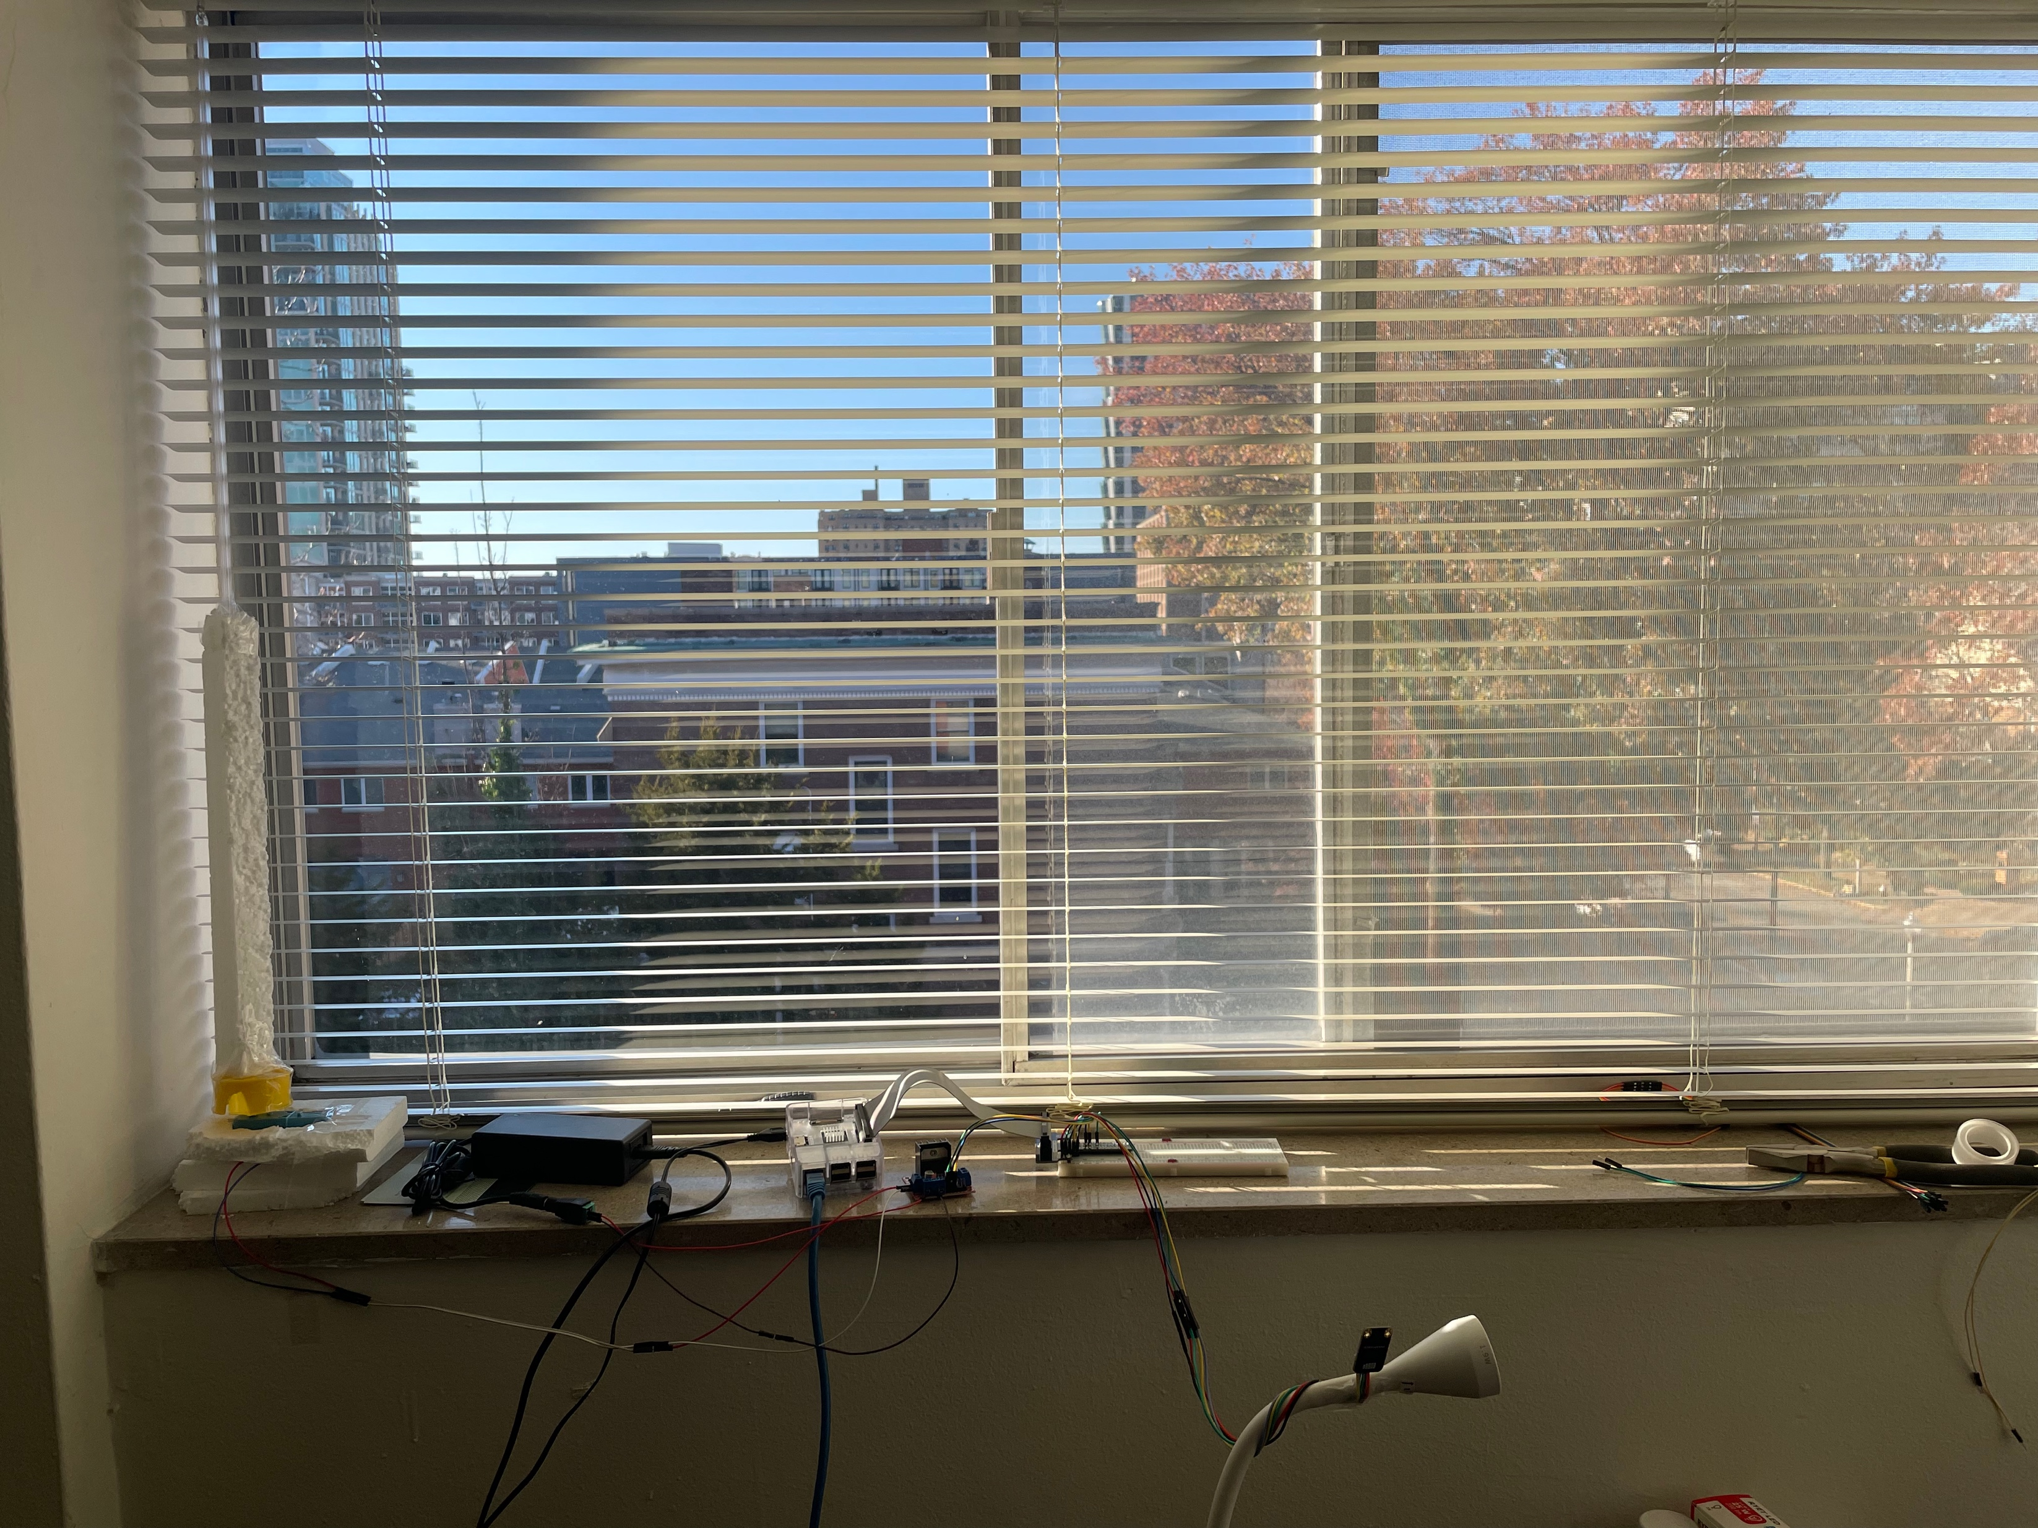
model design
foamed plastics+pole
Raspberry pi
Motor
L298N
Sensor

Slide 7
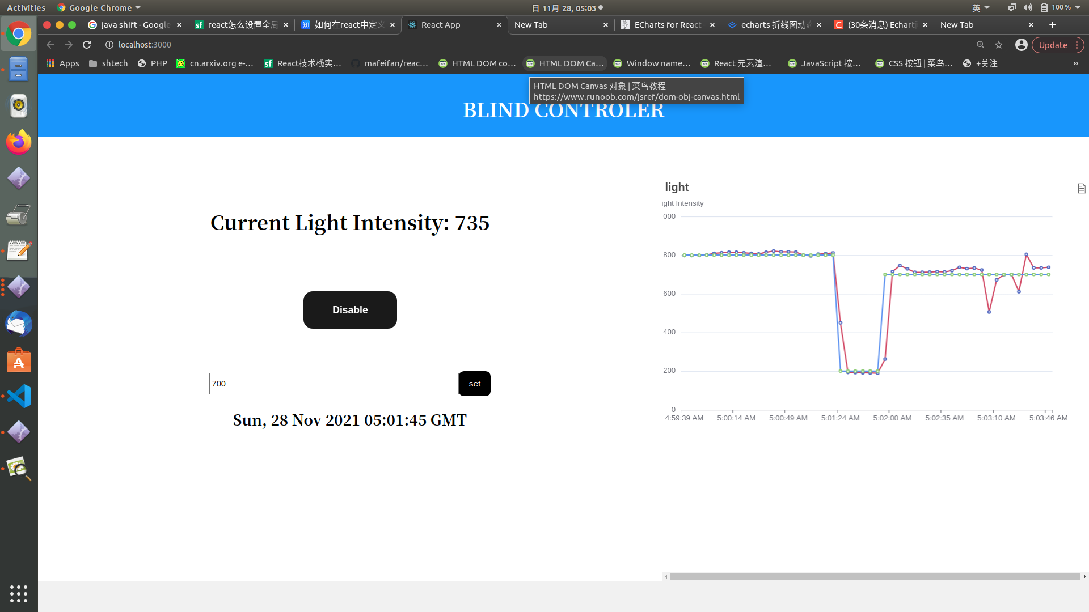

Slide 8
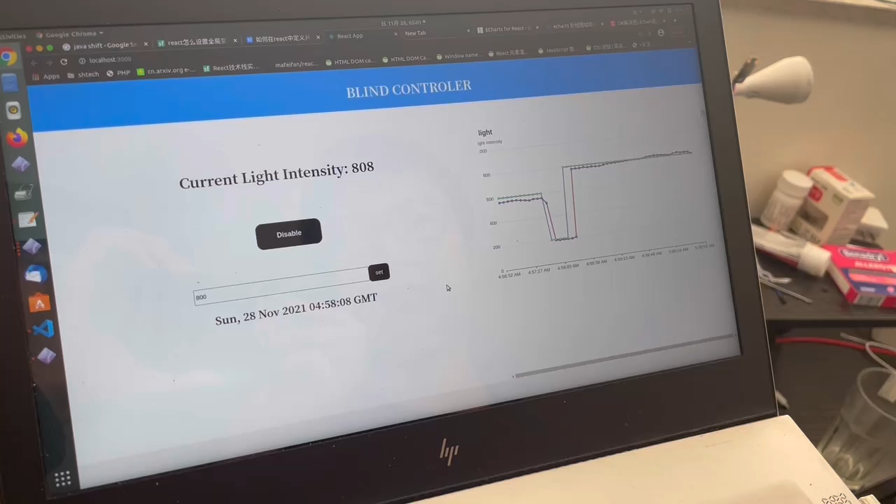

Slide 9
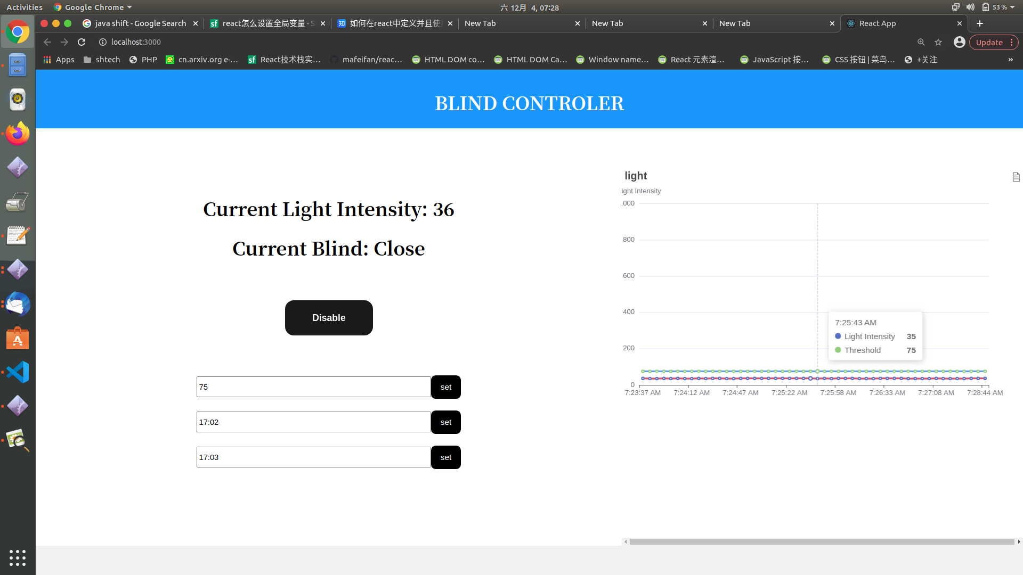

Slide 10
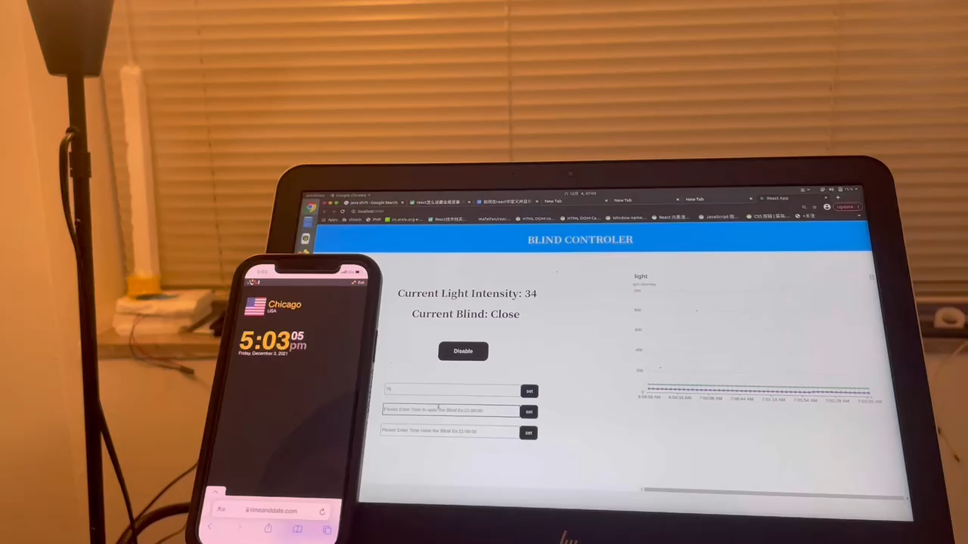

Slide 11
Thank you!

